Slide 1
Using Research to help fight dementia
By Jomar Alcantara
School of Engineering and Applied Sciences

Slide 2
Introducing me
BSc (Hons) in Psychology – Upper Second Class – London Metropolitan University
PG Dip in Psychological Therapies (IAPT Pathway) – Passed with Merit – University of Reading
MSc (Hons) in Data Science and Analytics – Passed with Merit – Royal Holloway (University of London)
8 Years as a qualified Psychological Therapist working primarily with mild to moderate anxiety and depression.

Slide 3
Agenda
What is dementia and why is it a problem?
My Journey
My first piece of research
My plan for the next 2 years
Conclusions
Notes:
What is dementia and why is it a problem?
Introduce myself
What my research is and how it might help?

Slide 4
What is dementia?
‘The word ‘dementia’ describes a set of symptoms that may include memory loss and difficulties with thinking, problem-solving or language. These changes are often small to start with, but for someone with dementia they have become severe enough to affect daily life. A person with dementia may also experience changes in their mood or behaviour.’
Alzheimer’s Society (2018)
Notes:
‘The word ‘dementia’ describes a set of symptoms that may include memory loss and difficulties with thinking, problem-solving or language. These changes are often small to start with, but for someone with dementia they have become severe enough to affect daily life. A person with dementia may also experience changes in their mood or behaviour.’

Slide 5
What is dementia? (2)
Cognitive Symptoms
day-to-day memory – for example, difficulty recalling events that happened recently.
concentrating, planning or organising – for example, difficulties making decisions, solving problems or carrying out a sequence of tasks (such as cooking a meal).
language – for example, difficulties following a conversation or finding the right word for something.
visuospatial skills – for example, problems judging distances (such as on stairs) and seeing objects in three dimensions.
orientation – for example, losing track of the day or date, or becoming confused about where they are.
Emotional Symptoms
Irritability, Low Mood.
Notes:
A person with dementia will have cognitive symptoms (to do with thinking or memory). They will often have problems with some of the following:
day-to-day memory – for example, difficulty recalling events that happened recently,
concentrating, planning or organising – for example, difficulties making decisions, solving problems or carrying out a sequence of tasks (such as cooking a meal),
language – for example, difficulties following a conversation or finding the right word for something,
visuospatial skills – for example, problems judging distances (such as on stairs) and seeing objects in three dimensions,
orientation – for example, losing track of the day or date, or becoming confused about where they are.
In addition to the cognitive stuff. People with dementia tend to have mood swings and experience more intense emotions such as irritability and anger. They also may see things that aren’t there, and they may believe things that aren’t really true.
Dementia is progressive, which means the symptoms gradually get worse over time. How quickly this happens varies greatly from person to person.

Slide 6
Prevalence in the UK
In 2015, there were 815,827 people with dementia in the UK, of whom 773,502 were aged 65 years or over. This represents one in every 79 (1.3%) of the entire UK population, and 1 in every 14 of the population aged 65 years and over.
The total cost of dementia to society in the UK is £26.3 billion, with an average cost of £32,250 per person.
£4.3 billion is spent on healthcare costs.
£10.3 billion is spent on social care (publicly and privately funded).
£11.6 billion is contributed by the work of unpaid carers of people with dementia.
Statistics produced by the Alzheimer’s Society.

Slide 7
Prevalence in the world
Dementia severity – among people with late-onset dementia:
55.4% have mild dementia
32.1% have moderate dementia
12.5% have severe dementia
Researchers estimate that 46.8 million people worldwide are living with dementia in 2015. This number will almost double every 20 years, reaching 74.7 million in 2030 and 131.5 million in 2050.
The total predicted cost of Dementia on the global economy this year is $1 Trillion US Dollars and will double in just 12 years.
Statistics produced by the Alzheimer’s Society and Alzheimer’s Disease International
Notes:
The total cost of dementia to society in the UK is £26.3 billion, with an average cost of £32, 250 per person.
£4.3 billion is spent on healthcare costs.
£10.3 billion is spent on social care (publicly and privately funded).
£11.6 billion is contributed by the work of unpaid carers of people with dementia.
The total predicted cost of Dementia on the global economy this year is $1 Trillion US Dollars and will double in just 12 years.
To put that into context, Apple is worth something like 800 billion dollars. Google just under 400 billion dollars. If Dementia was a country, it would be the 18th largest economy eclipsing the likes of Saudi Arabia, The Netherlands and Turkey.

Slide 8
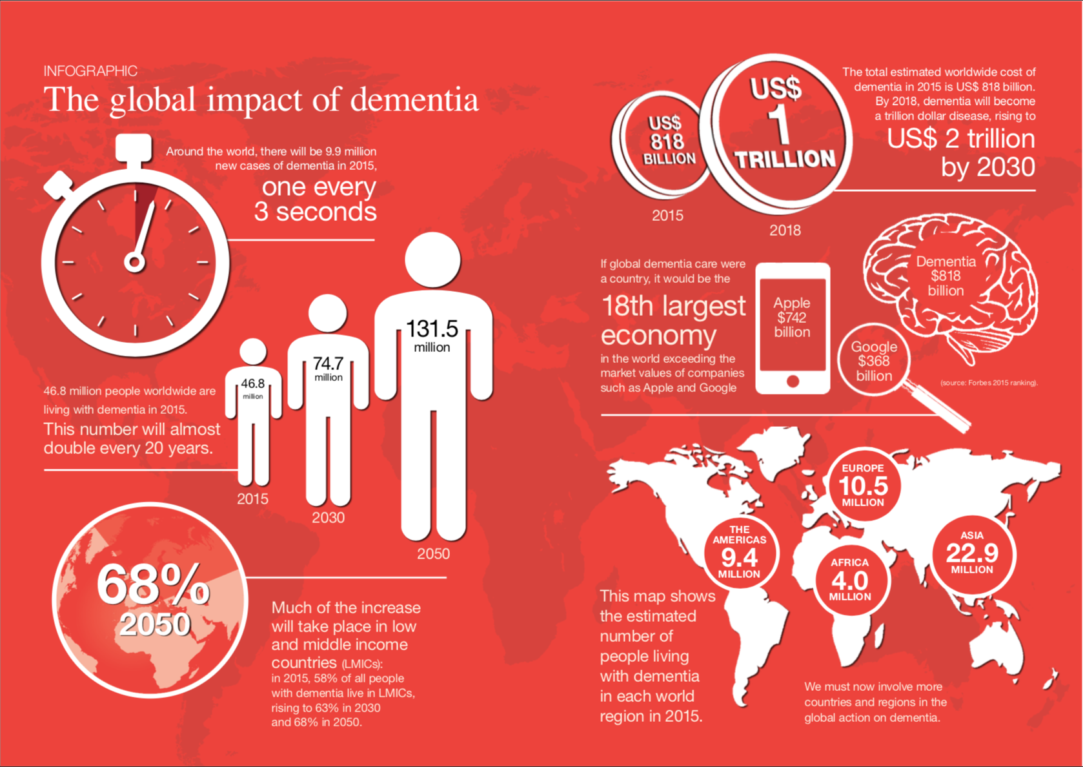
Taken with permission from the World Alzheimer’s Report 2015, published by Alzheimer’s Disease International

Slide 9
My Journey - Ambient monitoring of speech for cognitive decline to……
The Original Goal – To see if we can use technology to monitor speech and detect symptoms of cognitive decline earlier using devices such as the Google Home or the Amazon Echo.
The premise is sound in some ways. What we would like in an ideal world is a way of automating the collection of language samples in a non intrusive way.
However, the language generated by interactions with these devices, whilst would tap into the necessary cognitive functions and language generation skills thought to be affected by the symptoms of Dementia, would not be sufficient in terms of length or richness of speech.
Notes:
Several studies of at-risk youths have found that doctors are able to predict (~80% accuracy) whether a person will develop psychosis based on that person’s speech.
In a study conducted by IBM and Columbia University. They used an automated speech-analysis program to correctly differentiate—with 100-percent accuracy—between at-risk young people who developed psychosis over a two-and-a-half year period and those who did not. The computer model also outperformed other advanced screening technologies, like biomarkers from neuroimaging and EEG recordings of brain activity.”
An example of a feature they used to correctly classify those who would go on to develop Schizophrenia was disorganised speech.

Slide 10
The analysis of language USING natural language processing and machine learning to aid in the diagnosis of mild cognitive impairment.
Why Mild Cognitive Impairment and not dementia?
A large amount of literature has been devoted to looking at differentiating between those with Dementia and Healthy Older Adults. However this is, in some way a trivial task for most clinicians.
Let’s take a look at the Mini Mental State Examination (MMSE)
Self Report Questionnaire that tests orientation in time and place as well as naming and visuo-spatial skills.
Whilst there are numerous investigational drugs in development for the treatment of AD, a larger than normal percentage (99.6%) of these drugs fail in clinical trials (in contrast to anti-cancer drugs which have a 80% failure rate)
There is consensus among researchers and clinicians that MCI is a significant risk factor to developing AD.
Mild Cognitive Impairment (MCI) Due To Alzheimer's Disease/Prodromal Stage:
Mild Neurocognitive Disorder (mNCD)

Slide 11
Mild Cognitive Impairment
Concern regarding a change in cognition - A person or an informant should express concern that there is a change in cognitive ability in comparison to previous level of performance.
Impairment in one or more cognitive domains - There should be evidence of lower performance in one or more cognitive domains beyond what would be expected of a person given their age and education.
Preservation of independence in functional - Whilst persons with MCI are expected to be able to maintain independence, it is common to experience mild problems in complex functional tasks which they may have been able to perform previously. This might mean that they take more time or be less efficient at completing these tasks, or it may be that may make more mistakes.
Not demented - The deterioration should be mild to the point that there is no significant loss of functioning in social or occupational contexts.
NOTE: the diagnosis of MCI requires evidence of intra-individual change and optimally requires evaluation at two or more points

Slide 12
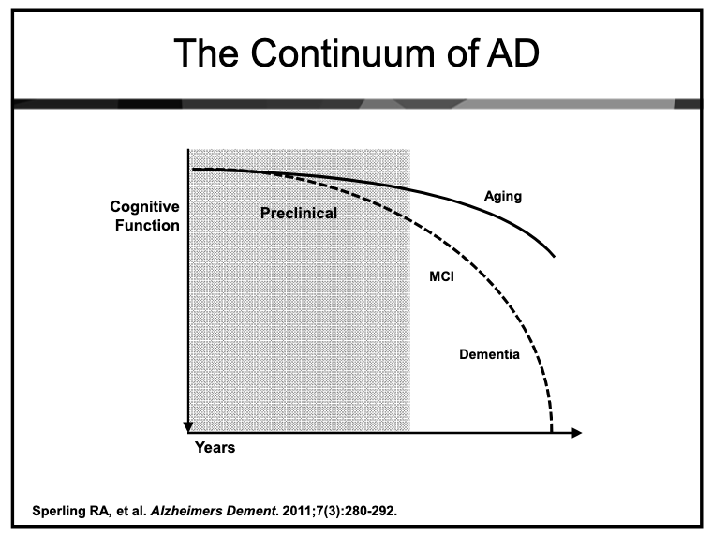

Slide 13
What’s wrong with the current research in this area?
Use of the MMSE as an indicator of MCI (range from 18 to 26) – Inconsistent and can we really characterize this as mild?
Generally research has looked at diagnosing MCI from one data point. As we saw from the definition above, it has been recommended that we look at two (or more time points). This is because the presentation of MCI is widely heterogenous.
There is a lack of consensus as to which language features are most important in diagnosing MCI.

Slide 14
What studies support this longitudinal approach?
Berisha and Liss (2015) Tracking Discourse Complexity Preceding Alzheimers Disease Diagnosis A Case Study Comparing The Press Conferences Of Presidents Ronald Reagan And George Herbert Walker Bush.
Le et al (2011) - Longitudinal detection of dementia through lexical and syntactic changes in writing: a case study of three British novelists.
Fraser et al (2015) - Linguistic Features Identify Alzheimer's Disease in Narrative Speech.
Snowdon (1997), Riley (2005) - Aging and Alzheimer's Disease: Lessons From the Nun Study & Early life linguistic ability, late life cognitive function, and neuropathology: findings from the Nun Study

Slide 15
What do I want to do differently?
Previous research has looked at historical datasets. I would like to generate my own longitudinal dataset with four distinct groups – Healthy Older Controls (HOC), Subjective MCI (sMCI), Diagnosed MCI (dMCI) and Early Stage Alzheimer’s (AD).
I would like to develop a machine learning model that will be able to distinguish between these groups using language features.
I would like to look at a comprehensive range of language features such that we can contribute to the research into which language features are most important in the diagnosis of MCI.

Slide 16
Research Aims and Hypotheses
(H1) Monitoring language samples and other measures of cognitive decline over the course of the year will be enough to detect cognitive decline in a population of those with Subjective Cognitive Decline and Mild Cognitive Impairment
(H2) Those with MCI will show a different language profile to controls if matched similarly for age, gender, education and other significant factors.
(H3) The new neuropsychological battery of tests will be more sensitive at detecting mild cognitive impairment than existing measures such as the RBANS.
(H4) Given a number of samples of language over a given time frame, it is possible to detect language decline in participants such that you can differentiate between normal language decline, those with Alzheimers Disease and decline in those with MCI.
(H5) Using individuals as their own control will be enough to identifytrends in the decline of their use of language.

Slide 17
Study 1 - Introduction
The analysis of language has been highlighted as a potential method for diagnosing Alzheimer's disease at its early or pre-clinical stages. This first study builds on the work of Berisha and Liss who looked at extracting language features from the non-scripted portions of press conferences from two US presidents, President Ronald Reagan, who would later go on to receive a diagnosis of Alzheimer's Disease and President George Bush Snr who received no such diagnosis. In our study, we add the transcripts of President Donald Trump who in terms of age is a much more appropriate match and we extract a larger variety of language features which have been shown to be associated with language decline due to Dementia.

Slide 18
Study 1 - Methods
I took 46 transcripts of Ronald Reagan’s (RR) press conferences from 1981 to 1988 and compared them with 134 press conferences by George Bush Snr (GHWB) and 29 press conferences conducted by Donald J. Trump (DJT). Berisha and Liss originally made the comparison as it GHWB (GHWB - age at the start of presidency - 64 years, 222 days) was the closest match to RR in terms of age (RR - age at the start of presidency, 69 years and 349 days). However, with the inauguration of Trump, he now is the closest comparable president in terms of age (DJT - age at the start of presidency - 70 years, 220 days).
I used the press conference transcripts in the American Presidency Project (APP) archive as a data source for this project. The APP is a comprehensive and organized searchable database of presidential documents, including transcripts of speeches, transcripts of news conferences, and other public documents.
I analysed transcripts for lexical features shown to change longitudinally with dementia. These features encompassed word level, sentence level and document level features and included a number of features contained in the study by Berisha and Liss.

Slide 19
Study 1 - Results
Once the features were extracted we completed a regression analyses. We found that President Reagan showed a significant decrease in unique words over time and his usage of nouns and adjectives. We also found that there was an increase in his usage of non-specific nouns, adverbs and pronouns. We found no significant trends in the transcripts of Presidents Bush and Trump

Slide 20
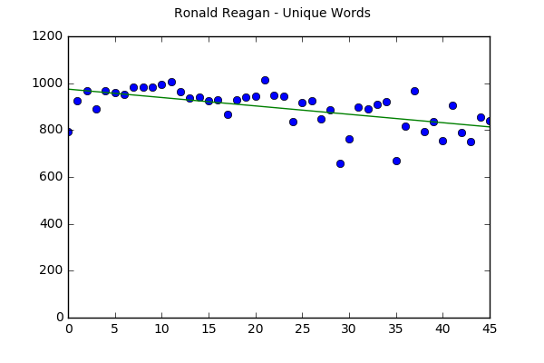
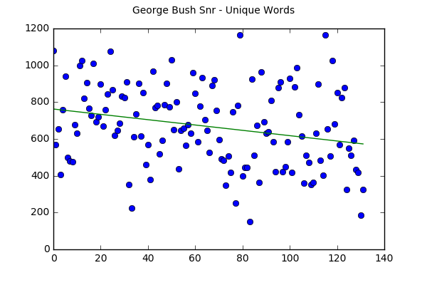
Results – unique words

Slide 21
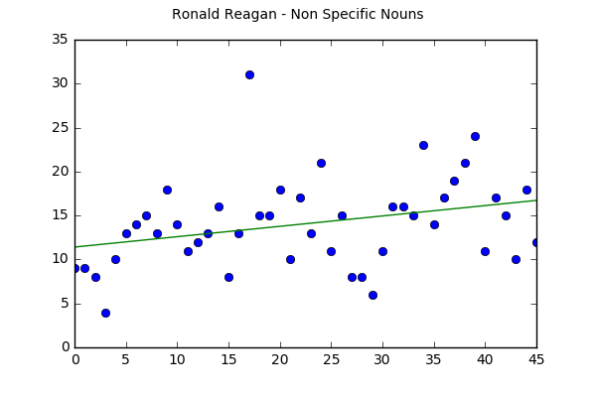
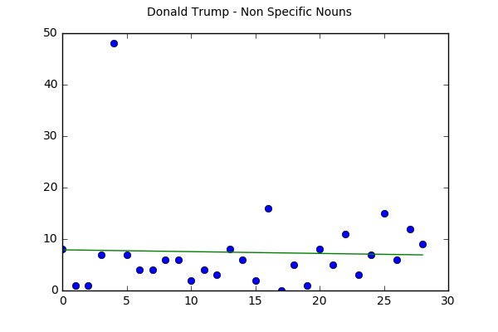
Results – Non specific Nouns

Slide 22
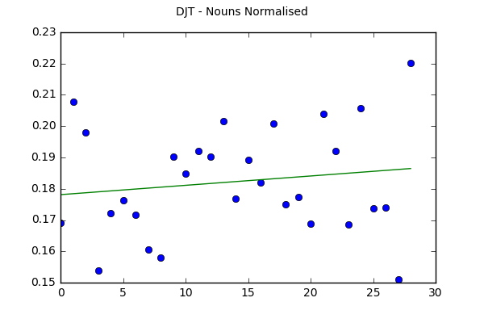
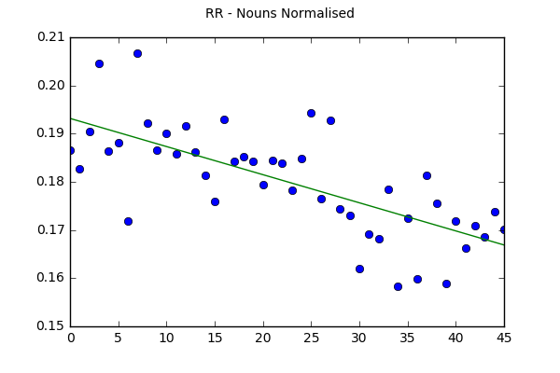
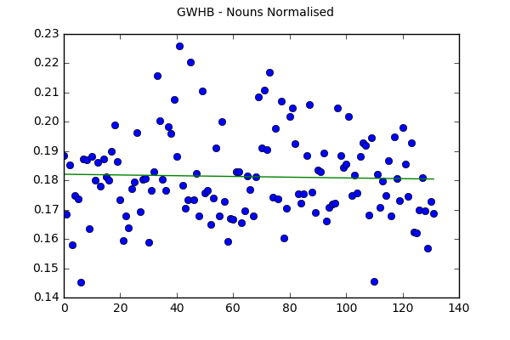
RESULTS – Nouns Normalised

Slide 23
More Results
 | Ronald Reagan | George H.W. Bush | Donald Trump
Word Count | -0.31* | -0.21* | 0.08
Unique Words | -0.56*** | -0.25** | 0.16
Non Specific Nouns | 0.30* | -0.08 | -0.03
Low Imageability Verbs | -0.19 | -0.20** | 0.02
Nouns Normalised | -0.70*** | -0.03 | 0.14
Verbs Normalised | 0.36** | 0.24*** | -0.03
Adjectives Normalised | -0.40** | 0.08 | -0.34
Adverbs Normalised | 0.41*** | 0.02 | -0.36*
Pronouns Normalised | 0.65*** | 0.13 | 0.07
* Denotes p < 0.05, ** Denotes p < 0.01, *** Denotes p < 0.001

Slide 24
Study 1 - Discussion
Despite differences in our methodology, our research supports the findings of Berisha and Liss in that we both find a significant decrease in unique words over time and an increase in non-specific noun usage. Compared to our controls (GWHB and DJT), we find some slight trends with GWHB but no such trends with DJT in his speech albeit his samples of speech span a shorter amount of time.
Additionally we found a highly significant increase in the use of pronouns for RR. This is supported by literature. Wendlestein et al propose that the increased used of pronouns is an expression of an impaired ability to adapt language to the listener's needs. Almor et al attributed this reliance on pronouns due to a impaired working memory.

Slide 25
Study 1 - Discussion
The decrease in overall noun usage has also been identified as a feature. Jarrold et al found that AD patients would use more pronouns, verbs and fewer nouns than controls.
This study shows that language deterioration can be tracked over time in those with Mild Cognitive Impairment and is generally differentiable from healthy controls. The results also potentially demonstrate the utility of longitudinal language analysis as a method of diagnosing Mild Cognitive Impairment in the future.

Slide 26
Plan for the next 2 years
Task 2 – Pilot Study of our Language Collection Tasks and Repeated Neuropsychological Battery of Tests
Duration – February ‘19 and March ‘19
Task 3 – Analysis of the DementiaBank dataset and the three authors dataset.
Duration – April ‘19 – September ‘19
Task 4 – Longitudinal Study
Duration – May ‘19 – December ‘20
Task 5 – Analysis of the Neuropsychological Battery of Tests
Duration – May ‘19 - December ‘20

Slide 27
Task 2– Pilot Study of our Language Collection Tasks and Repeated Neuropsychological Battery of Tests
The aim of this study is complete a trial run of the administration of a new battery of neuropsychological battery of tests. We aim to find out whether the tests in question generate enough language so that features such as those generated in Task 1 are meaningful and can be used as language markers that can then be tracked over time. We also aim to look at whether there are significant practice effects between three versions of these tests with a gap of seven days between each test.

Slide 28
Task 3– Analysis of the DementiaBank dataset and the three authors dataset.
The aim of this task is to replicate and extend the work of Fraser (2015) and Orimaye (2014) who both used the DementiaBank dataset and set out to use traditional machine learning techniques to see whether they could categorize people into dementia or healthy categories using the samples given. We also aim to replicate and extend the work of Le et al who used electronic versions of the novels of three authors. Both datasets are longitudinal and have been shown to track language decline over time in different ways.

Slide 29
Task 4 and 5– Longitudinal Study
The aim of this task is see whether a formalised collection of specific data, namely our language tasks are enough to be able to be able to detect cognitive decline in participants at different stages of the MCI / Alzheimer's disease progression. To this end, we plan on administering our neuropsychological battery of tests from Task 2 to each participant three times (six monthly intervals) over the course of the year.
We will be looking at the results of just the language tasks, the results of the neuropsychological battery of tests without the additional language tasks and in combination to determine whether we can detect cognitive decline.

Slide 30
Research Challenges
Data Collection
There are a few challenges that I have identified with the process of data collection. As with all longitudinal studies, the data collected is only valid if there are at least two sets of data points for a given participant. Given the population I am exploring, it is expected that there is some level of drop out rate over the course of the year and this has been accounted for. Nevertheless, a higher than average drop out rate would weaken the strength of the study, especially if those who dropped out came from the experimental group.
Commonality of MCI
Whilst research has consistently shown that those with a diagnosis of MCI tend to have a significantly higher risk of progression to dementia. The progression at any given time is low and variable. Annual conversion rates vary across longitudinal studies conducted in this population, but researchers have shown that there is a higher conversion rate in clinical samples of this population than in community samples [86]. In my proposed longitudinal study, I aim to collect a clinical MCI population, but depending on the availability of such samples I may have to collect from the community. If this is the case then, the prevalence of those with MCI who have language deficits within my participants may be low.
Sparsity of Language
I have tried to estimate the amount of language I will collect by conducting a pilot study on healthy controls. However, until the first sets of data collection with the MCI population, I will not be able to tell if this is a problem. I fully expect there to be little difference in the amount of language collected in the MCI population, but this remains a possibility which I will need to adjust for at the 2nd and 3rd data collection phases.
Sparsity of Data Points
Whilst my study on the Presidents Press Conferences was successful, this included quite a large number of time points. It will be a challenge to draw robust conclusions from language from a maximum of three data points. The only

Slide 31
How could my research change things?
If our goal is to detect dementia and/or cognitive decline earlier, we need to be analyzing speech earlier.
There has already been been some research in this area. Based around the language analysis of those who have completed the above assessments and those tests being transcribed and the results have been promising. However, this still doesn’t solve the problem!
Benefits of diagnosing earlier.
Being able to increase research into the early development of a disease, and potentially a cure.
Active treatment in the early stages could be able to delay the onset of more severe symptoms.

Slide 32
Wait a minute, what about Machine Learning?
So I mentioned Machine Learning. On top of developing a protocol for collecting data, it would be useful to see whether we can classify our participants based on the relative decline of their language skills. Whilst we do not want to compare participants with their peers directly, we do need to ascertain whether or not their decline is in keeping with general decline with age or if the decline is more accelerated. One idea would be to feed a machine learning classification algorithm with data containing the decline of various language characteristics.
 | Word Count | Unique Words | Non-Specific Nouns | LI Verbs | Nouns Normalised | Verbs Normalised | Adject.. Normalised | Adver.. Normalised | Pronouns Normalised | Label
RR | -0.31 | -0.56 | 0.30 | -0.19 | -0.70 | 0.36 | -0.40 | 0.41 | 0.65 | AD
GWHB | -0.21 | -0.25 | -0.08 | -0.20 | -0.03 | 0.24 | 0.08 | 0.02 | 0.13 | HOA
DJT | -0.08 | 0.16 | -0.03 | 0.02 | 0.14 | -0.03 | -0.34 | -0.36 | 0.07 | HOA

Slide 33
Deep learning As An Alternative
Deep Learning
Deep Learning is the potentially more effective as it removes the feature engineering portion of this task. However the downside is that it takes a significant amount of data for the deep learning models to obtain accurate predictions and currently this may not be feasible.
There is an argument for the use of normal speech as a way of increasing the amount of data used by this model and a recent article by Balagopalan (2018) suggests that the addition of a significant amount of healthy older adult speech could potentially increase AD detection by up to 9%

Slide 34
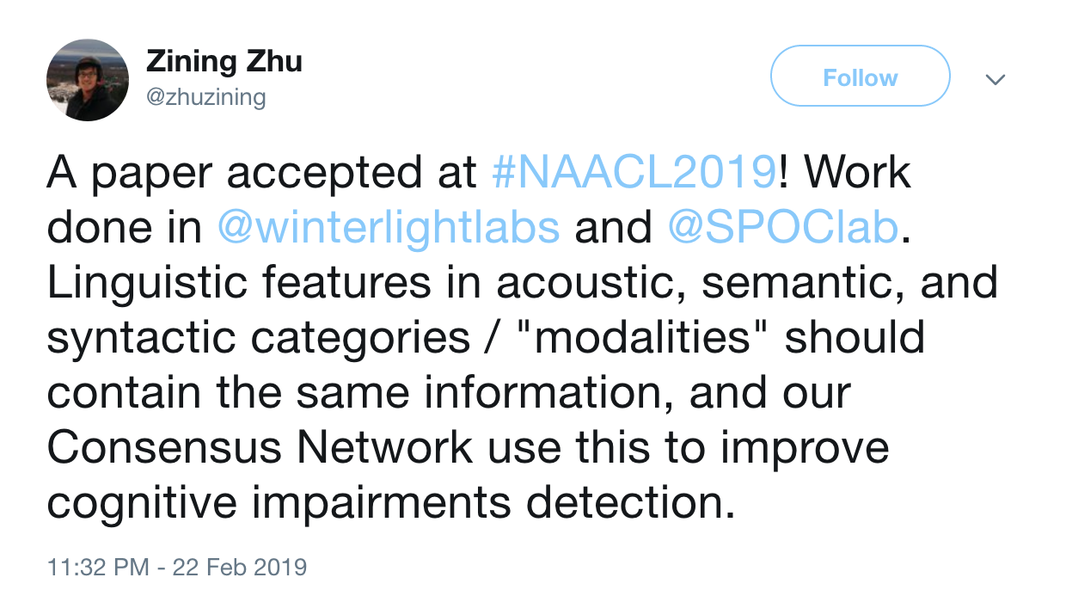
Breaking News - How does this impact my research?

Slide 35
Reflections on the year
The Good
I’m really enjoying the topic.
Being Organized in terms of papers and reading.
Writing is slowly something I’m getting more comfortable with.
The Bad
Finding my best way of working has taken some time.
Juggling multiple project tasks has also taken some time
The things I still need help with
Career planning including raising my profile and networking
Maths!

Slide 36
Conclusion
Dementia is a growing, global problem that is only getting bigger as our population grows.
There is a increase growing need to understand how dementia in the early stages progresses.
An early diagnosis also helps to plan for the future.
My research is an exploration of whether machines and technology can aid in the early diagnosis of dementia and other mild cognitive impairments.
The potential benefits are increased opportunities in research of dementia in the early stages, aiding the diagnostic process, increasing our understanding of the very early (non-clinical) stages of dementia and allowing early intervention to improve quality of life.
Notes:
It helps people to plan ahead while they are still able to make important decisions on their care and support needs and on financial and legal matters. It also helps them and their families to receive practical information, advice and guidance as they face new challenges.

Slide 37
QUESTIONS?

